Slide 1

Secure Data Encoding and Retrieval using Steganography
Internal Guide: Mrs.Ch.Mandakini
Assistant Professor,CSE Dept
Presented by:
L Vaishnavi - 22251A0519
Aparna - 22251A0533
B.Nithya -22251A0535
K.Sreeja -22251A0546

Slide 2
INTRODUCTION
With the rise in sensitive data transmission over the internet, ensuring secure communication is essential.
Cryptography and steganography are two primary fields addressing data security.
Cryptography: Converts data into unreadable forms.
2. Steganography: Conceals data within media like images, audio, and videos.
Steganography provides a discreet, efficient, and lightweight alternative to traditional cryptographic methods.

Slide 3
LITERATURE SURVEY
Title And Author | Journal And Year | Description | Limitations
A Secure Image Steganography Based on Cryptography Technique (Lokesh Kumar & et al.) | International Journal, of Advanced Sciences, 2019 | Proposes an improved LSB technique for embedding data in images while maintaining quality. | Limited to image-based steganography; does not address robustness against advanced attacks.
Audio Steganography: An Overview(Sharma, Tanuja) | IEEE Transactions, 2020 | Explores audio steganography techniques and their robustness to compression and noise. | Focuses primarily on theoretical methods; lacks practical implementations for real-world scenarios.
A Survey on Video Steganography Techniques (Tiwari, Ajit Kumar, et al.) | Springer, 2023 | Reviews methods for embedding data in video files, focusing on DCT and motion vectors. | High computational complexity; limited exploration of lightweight or real-time techniques.

Slide 4
EXISTING SYSTEM
Pattern substitution embeds secret data by replacing specific patterns or pixel groups in the cover image with predefined alternatives, allowing information to be hidden within visual structures.
Bit-level modulation often has limited data-hiding capacity as it relies on unused or redundant bits in image files. This can constrain the amount of information that can be concealed.
Naive Appending, appends secret data to the end of the cover file, making it extremely easy to detect or remove during file inspection, conversion, or re-saving, as the data is not truly hidden but simply attached.
High-order bit embedding hides data by modifying the more significant bits of pixel values, allowing for increased embedding capacity and stronger signal strength compared to lower-bit methods.

Slide 5
DRAWBACKS
Pattern substitution can degrade visual quality, is easily detectable due to noticeable distortions and predictable patterns, lacks robustness against compression or editing, and is unsuitable for detailed or high-resolution images.
Modifying higher-order bits can distort the image and affect quality.
Limited capacity: Only small amounts of data can be embedded without distorting the image.
Appends secret data at the end of the cover file, acting as simple piggybacking rather than true hiding. This makes it easy to detect or strip during file inspection or conversion.

Slide 6
PROPOSED SYSTEM
The proposed system employs Least Significant Bit (LSB) steganography with additional encryption layers, ensuring that hidden messages within images are secured and accessible only to authorized users possessing the correct decryption key.
To enhance reliability, the system incorporates error detection mechanisms, enabling users to verify the integrity of hidden data and recover messages in case of corruption or data loss during transmission.
The system is optimized for images, making it an efficient and versatile solution for embedding and extracting concealed information within various image file formats.

Slide 7
PROBLEM STATEMENT
The project focuses on developing a platform for securely hiding sensitive data within media files using advanced steganographic techniques. It enables users to encode and decode hidden information efficiently while ensuring data confidentiality and minimizing visual distortions in the media files. The system addresses the growing need for secure and covert communication in digital mediums.

Slide 8
OBJECTIVES
To develop a platform for secure encryption and decryption of large data volumes embedded within multimedia files (Audio, Video, Images).
To implement an LSB-based algorithm optimized for embedding and extracting data without perceptibly degrading file quality.
To ensure scalability to handle large data payloads across various file formats (e.g., PNG, BMP, JPEG, MP4, WAV, MP3).

Slide 9
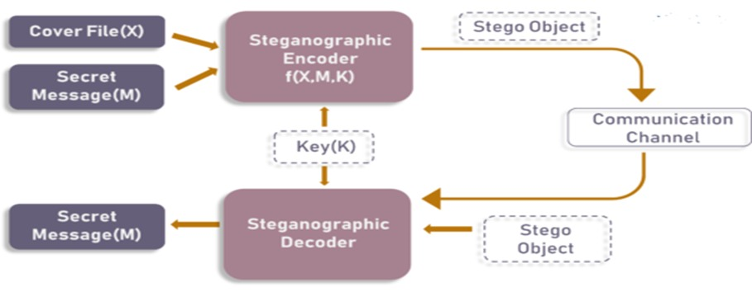
ARCHITECTURE

Slide 10
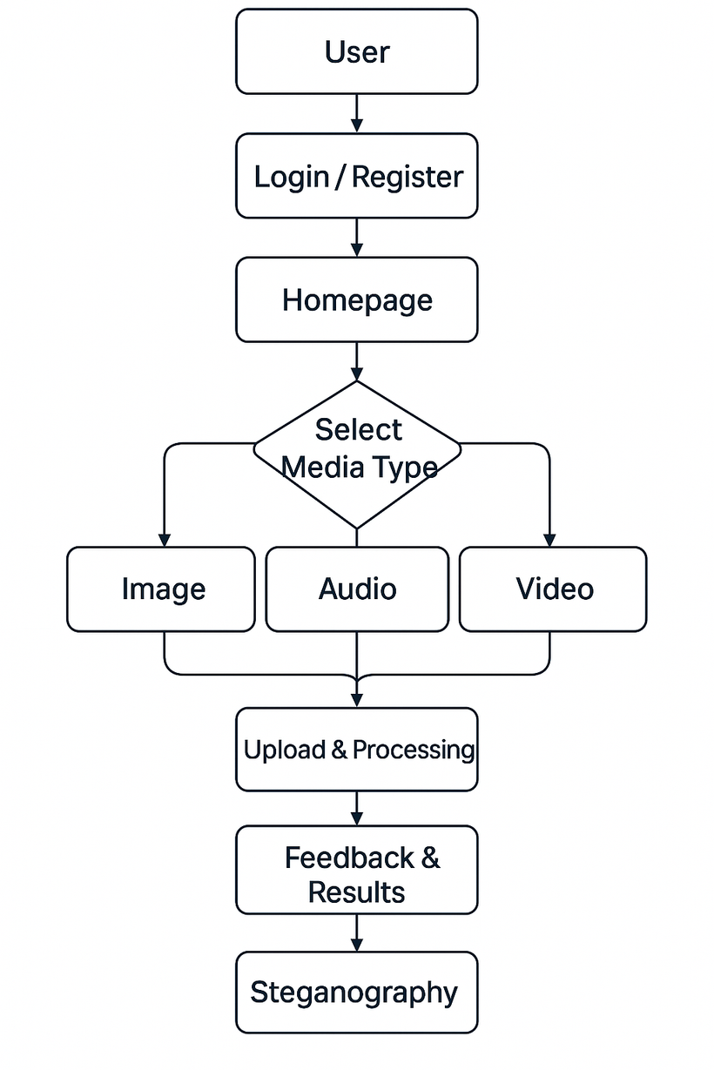
FLOW DIAGRAM

Slide 11
METHODOLOGY
1. User
The process starts with a user who wants to hide or retrieve secret data using the system.
2. Login / Register
New users need to register with basic credentials.Returning users simply log in to access the features.Ensures authentication and user access control.
3. Home Page
After login, users are redirected to the homepage.This serves as the navigation hub to all functionalities like selecting media type and uploading files.

Slide 12
METHODOLOGY
4. Select Media Type
Users choose the type of cover media for hiding the secret message: Image, Audio, Video.This step determines how the data embedding will be performed.
5. Upload & Processing
The selected media file is uploaded.The system then processes the file using appropriate steganography techniques based on the media type.Secret message is embedded into the media file in a non-detectable way.

Slide 13
METHODOLOGY
6. Feedback & Results
Once processing is complete, the system returns feedback:
Confirmation of successful embedding.
Option to download the stego file (media with hidden message).
If decoding, it shows the extracted message instead.

Slide 14
ALGORITHM
The LSB (Least Significant Bit) algorithm is a steganography technique used to hide data within a carrier file, such as an image, audio, or video. It works by replacing the least significant bit of each pixel or data unit with bits of the secret information.
Encoding:
Convert the secret message into binary.
Replace the least significant bit (LSB) of each pixel in the image with the bits of the message.
Save the modified image as the stego image.
Decoding:
Extract the LSBs from each pixel of the stego image.
Reconstruct the original message from the extracted bits.

Slide 15
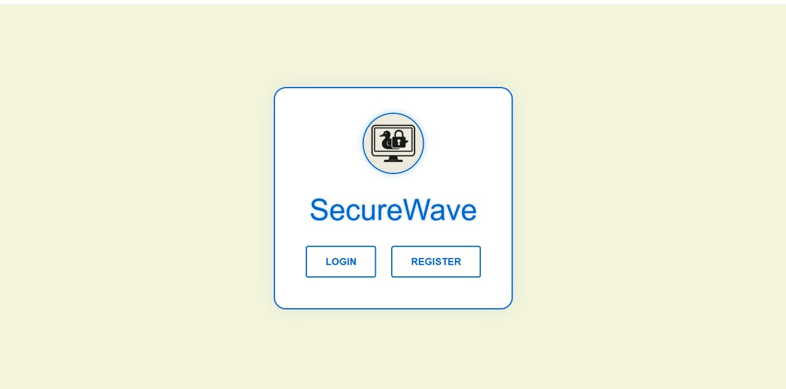
RESULTS
Main page

Slide 16
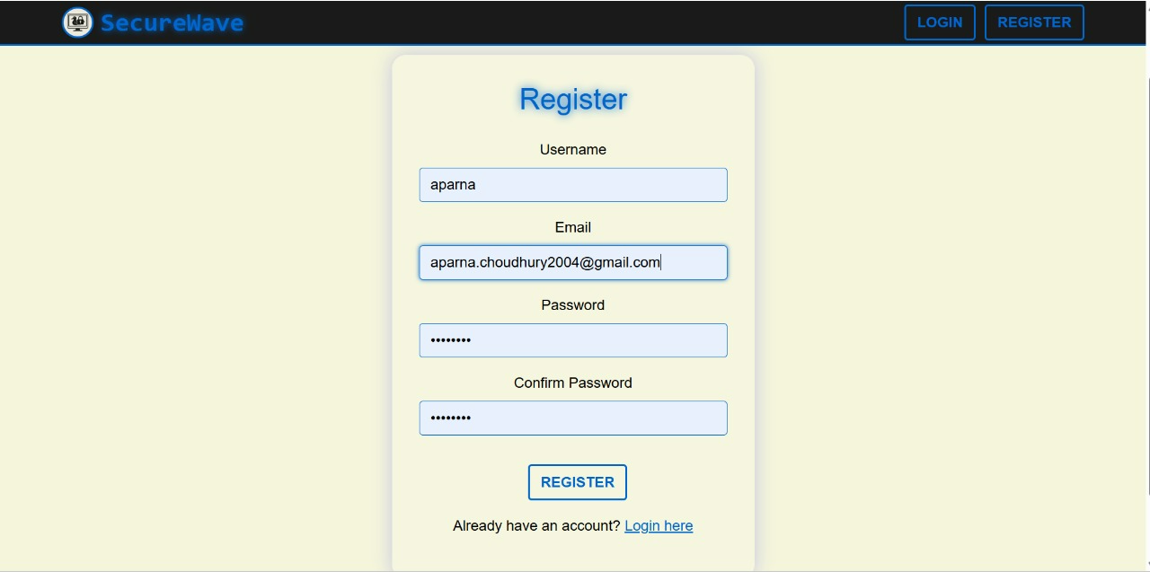
Registration page

Slide 17
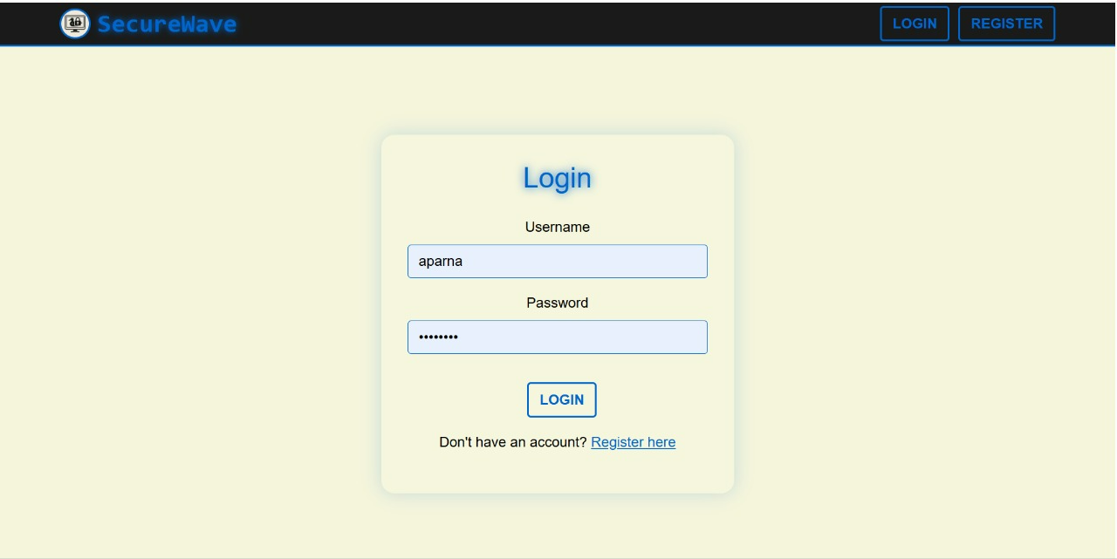
Login page

Slide 18
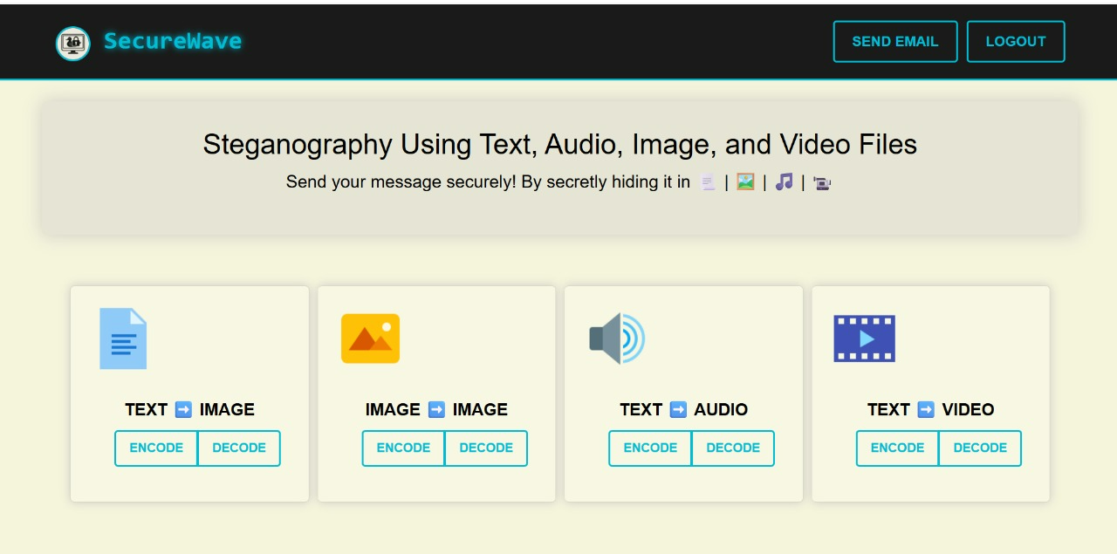
Home page

Slide 19
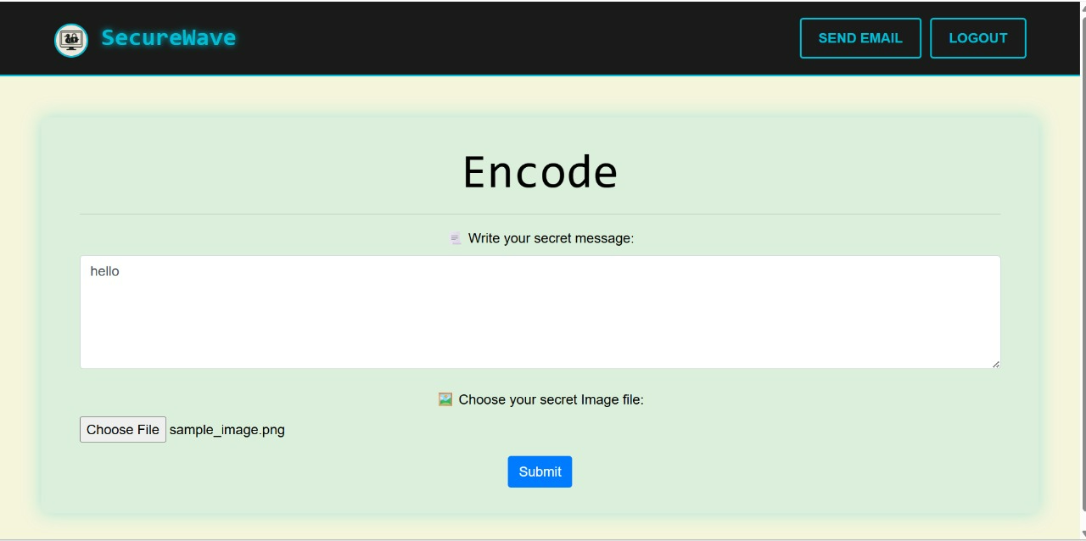
Encoding images with secret message

Slide 20
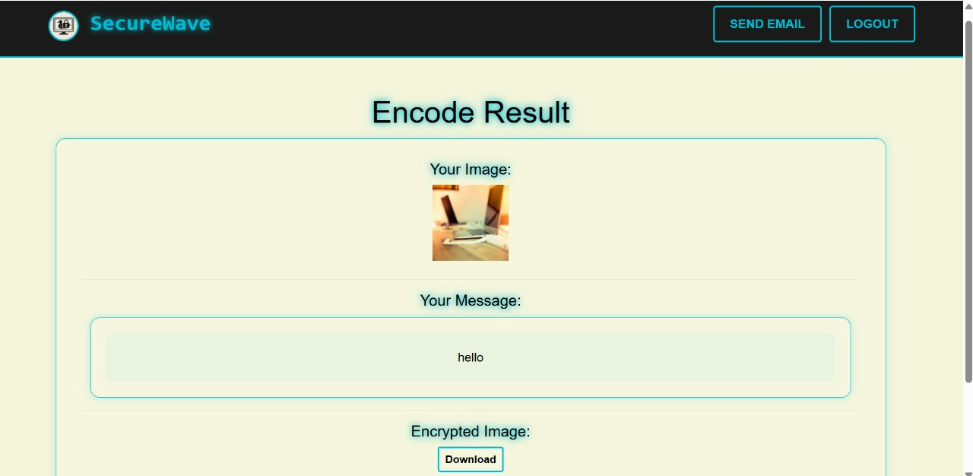
Encoding result

Slide 21
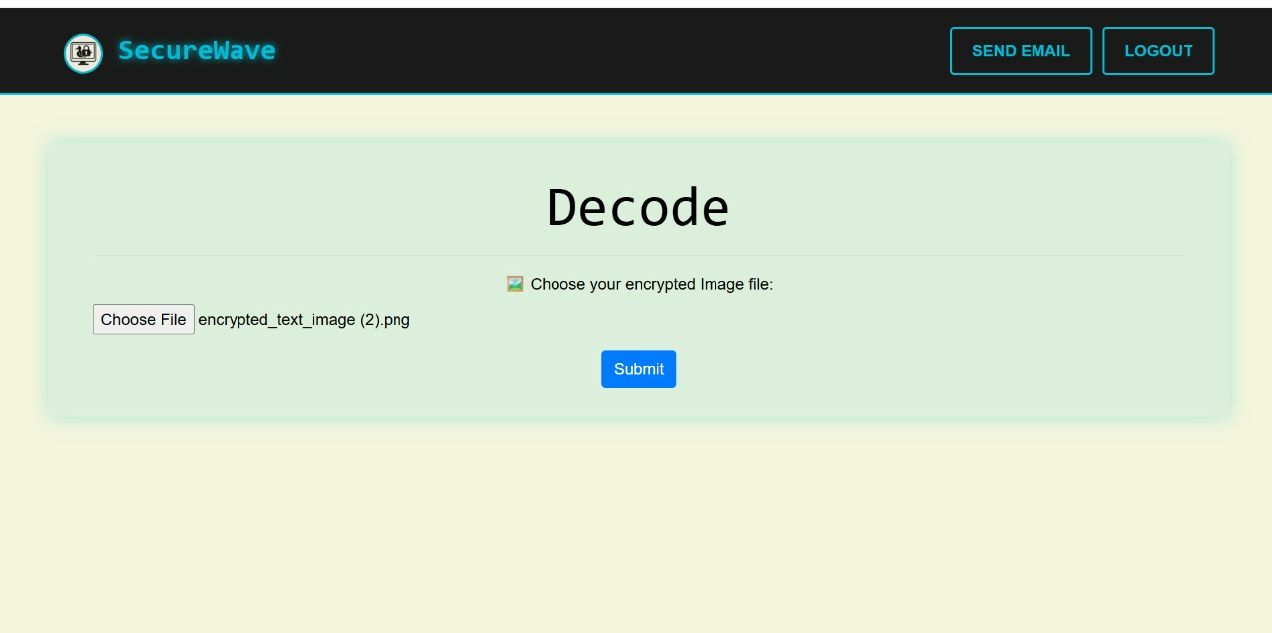
Decoding images with secret message display

Slide 22
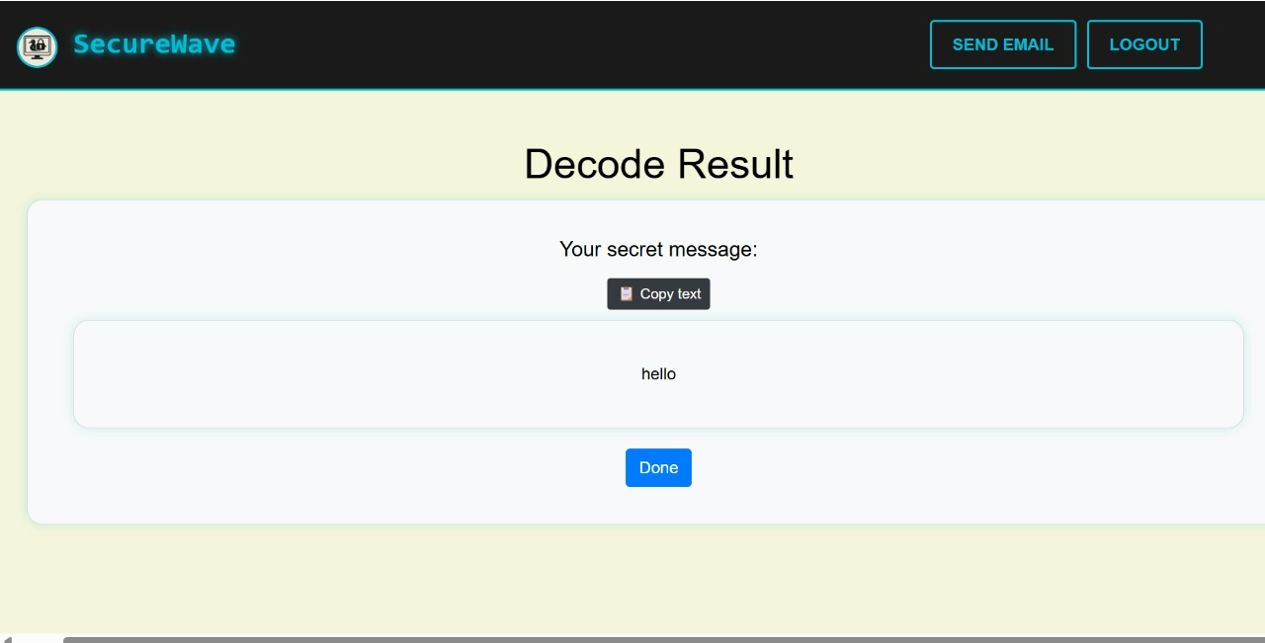
Text to Image decode result

Slide 23
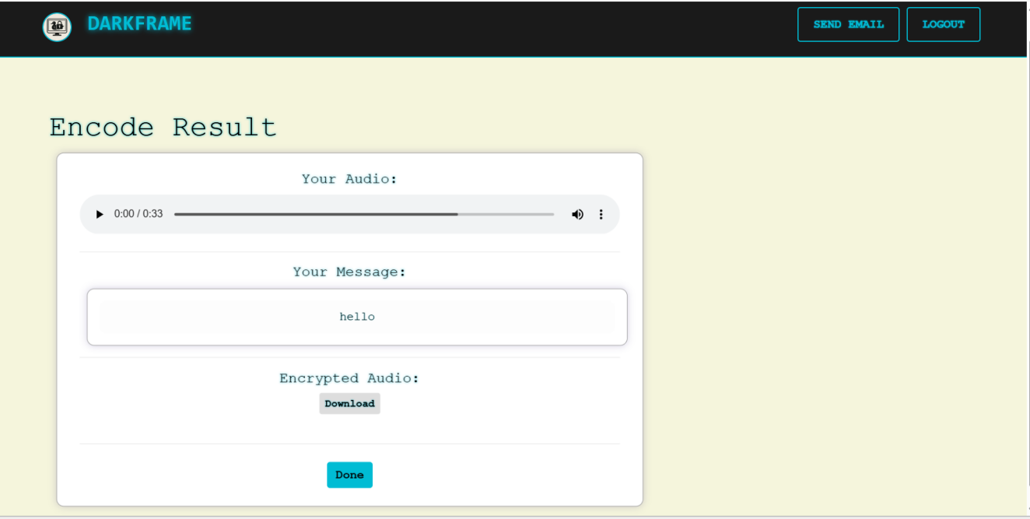

Encoding audio files

Slide 24
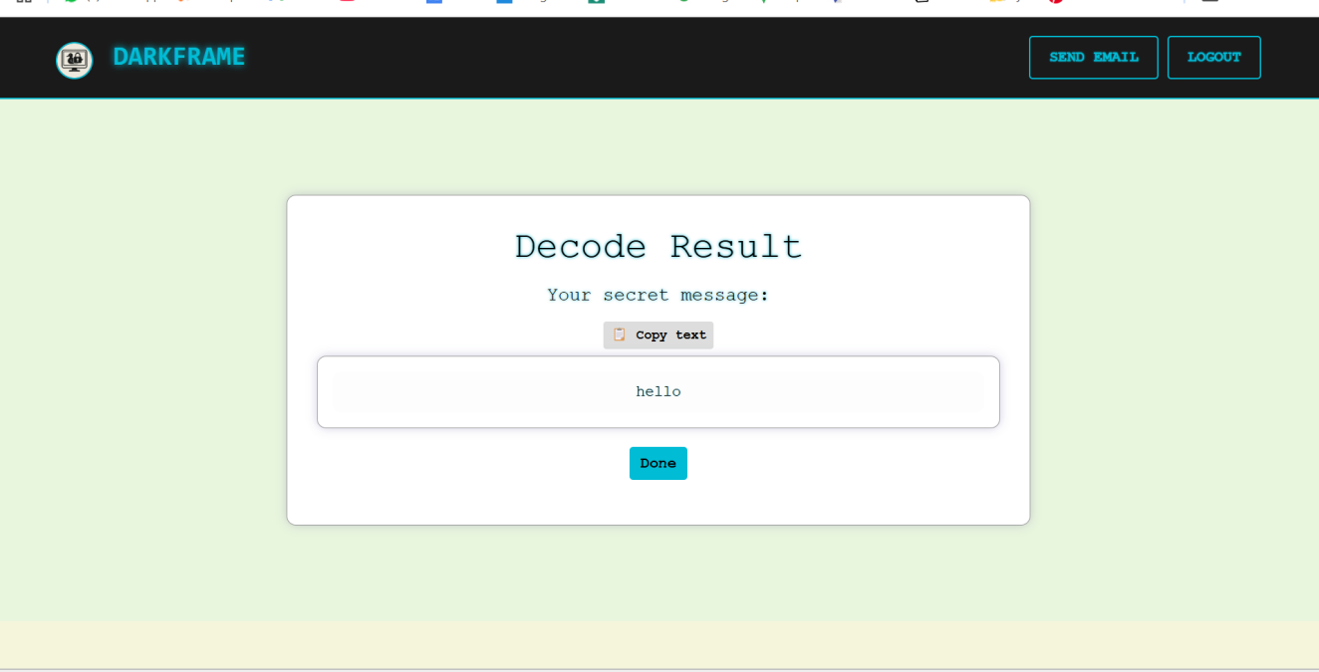
Decoding audio files

Slide 25
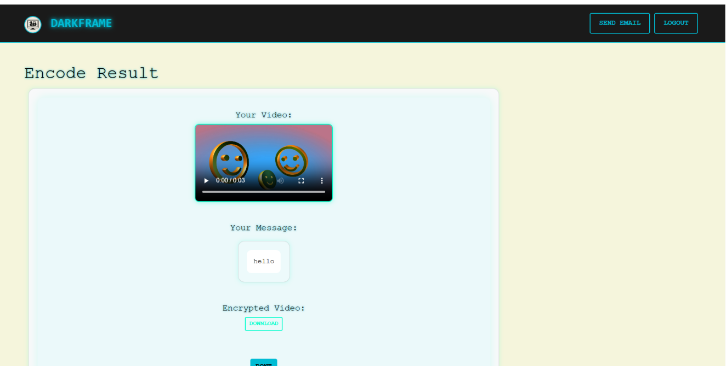

Encoding video files

Slide 26
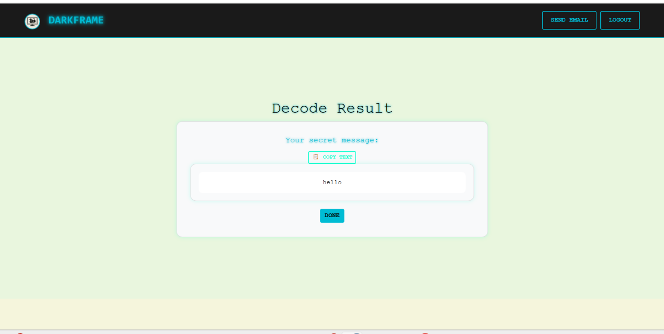
Decoding video files

Slide 27
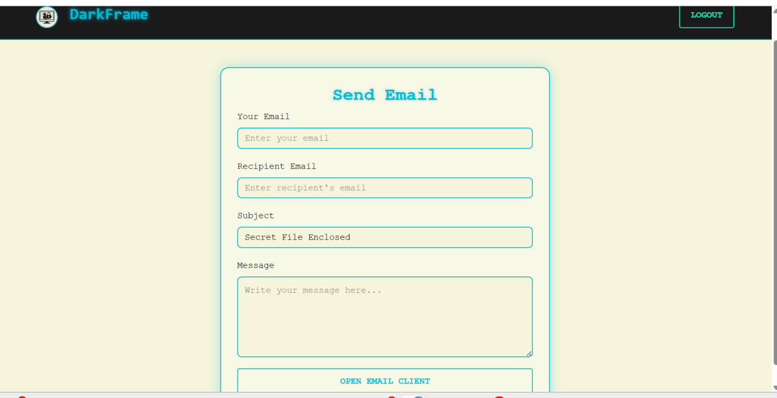
Email communication page

Slide 28
CHALLENGES
Capacity vs. Quality: A trade-off between embedding a large amount of data and maintaining image quality.
Image Quality: Embedding too much data can degrade the quality of the image.

Slide 29
CONCLUSIONS
Steganography is a powerful technique for hiding sensitive data in multimedia files. The LSB method is popular due to its simplicity.
Support for multiple media types—image, audio, text and video —adds versatility and real-world applicability to the system.
The implementation of techniques like LSB ensures that data embedding remains subtle and non-disruptive.
The system offers clear feedback, allowing users to download stego files or view extracted messages with ease.
Future Scope: Further research on more secure and efficient steganography techniques, especially for video and audio files.

Slide 30
REFERENCES
Ritu Sindhu,Pragathi Singh(2023).“Information Hiding in Image Using Steganography”.International Journal of Engineering And Advanced Technology,10.35940
Chen, L., & Xu, D. (2023). “Secure Data Hiding in Digital Images Using LSB and Cryptographic Algorithms.”IEEE Transactions
Patil, P., & Patil, S. (2022). “A Novel Approach to Image Steganography Using Deep Learning .” International Journal of Computer Applications, 975, 88–87
Ravi, S., & Kumar, P. (2020). “Data Hiding Techniques: Fundamentals and Advances in Steganography and Watermarking.” CRC Press.
Mangla, F. U., Nokhaiz, S., Ramzan, M., & Shah, M. A. (2019). “A Novel Steganography Technique Using Grayscale Image Segmentation.” International Journal of Advanced And Application Sciences,80-87

Slide 31
THANK YOU

